Slide 1
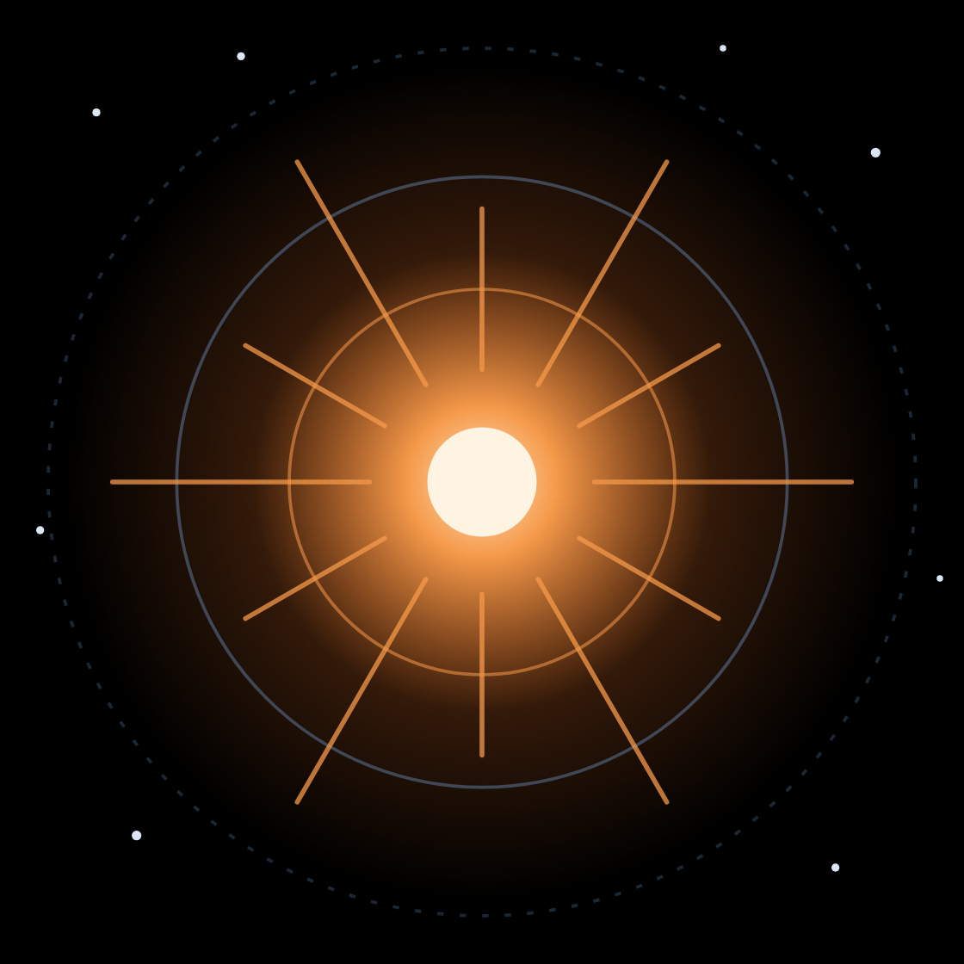
The BOOM Broker
RUBIN ML TRAINING SCHOOL 2026
Capabilities and features of a multi-survey alert broker for the Rubin era
Sushant Sharma Chaudhary · University of Minnesota
Notes:
~30 s. Introduce yourself and the goal of the talk: by the end, you should know what an alert broker is, what makes BOOM different, and why it is a good place to get Rubin data for your ML work. My colleague’s talk right after this one shows how to pull that data from the API, hands-on.

Slide 2
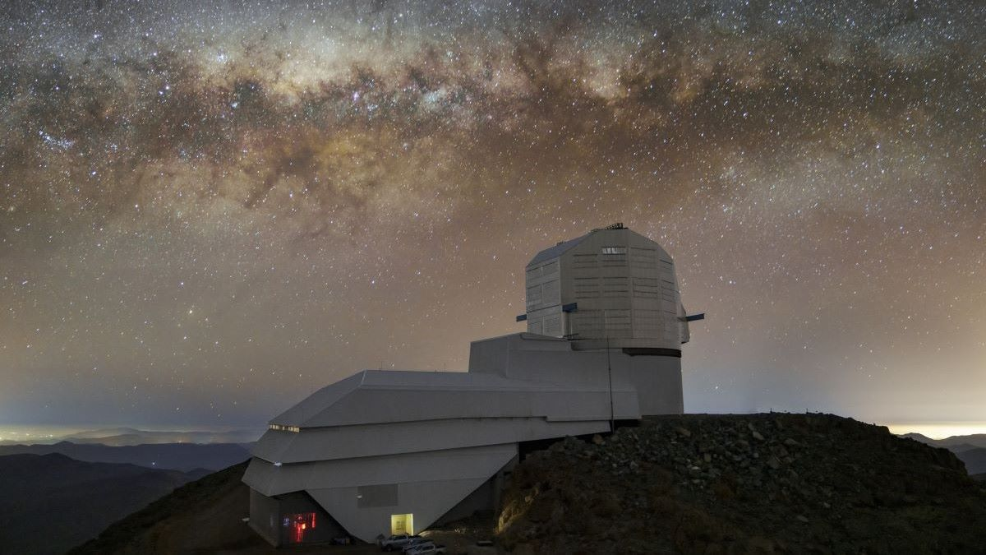
~10 million
01 · THE LSST ERA
alerts per night from Rubin’s Legacy Survey of Space and Time (LSST)
8.4 m mirror
~18,000 deg²
~60 seconds
3.2-gigapixel camera, 9.6 deg² per exposure
of southern sky, revisited every few nights for ten years
from shutter close to alert, by design
Notes:
~1.5 min. Set the scale. Rubin’s LSST produces on the order of ten million alerts per night. An alert is any significant change relative to a template image: a supernova, a flaring star, an AGN, an asteroid, or an artifact. Each alert ships with its recent history and image cutouts. Rubin issues alerts within about a minute of the exposure, so everything downstream has to keep up. (Numbers are the Rubin design figures; check them against the latest Rubin documentation before the talk.)

Slide 3
Alert rates: ZTF vs. Rubin
01 · THE LSST ERA
 | ZTF | Rubin LSST
Aperture | 1.2 m | 8.4 m
Field of view | 47 deg² | 9.6 deg²
Single-visit depth (r) | ~20.5 mag | ~24.5 mag
Alerts per night | ~10⁵–10⁶ | up to ~10⁷
Sky | Northern | Southern
10–100× more alerts, ~4 magnitudes deeper — and the same number of astronomers to look at them.
Notes:
~1.5 min. ZTF taught the community how to work with public alert streams: Kafka, Avro packets, brokers, marshals. Rubin keeps that model but scales it by one to two orders of magnitude in alert rate and about four magnitudes in depth. The punchline is the last line: the number of people available to look at alerts does not grow. That gap is what brokers and ML have to close. (Approximate values from the ZTF and Rubin design papers; check before presenting.)

Slide 4
Unprecedented depth
01 · THE LSST ERA
+4
magnitudes deeper per visit
r ≈ 24.5 for Rubin versus r ≈ 20.5 for ZTF
~40×
fainter in flux
10^(0.4 × 4) ≈ 40: sources no alert stream has shown before
~250×
more volume for the same transient
Reach grows ~6× in distance, so volume grows as its cube
Notes:
~1.5 min. Four magnitudes is a factor of about 40 in flux. For a standard candle, that pushes the reach out by 10^(4/5), about 6.3 times in distance, so roughly 250 times the volume (ignoring cosmology and K-corrections). Consequences: many more distant and rare events, many more faint host galaxies without spectroscopic redshifts, and a much larger fraction of alerts that no one will ever get a spectrum of. Context from catalogs and photometric redshifts becomes essential, which is where BOOM comes in later.

Slide 5
Rubin is a transient-finding machine.
01 · THE LSST ERA
It will find far more transients than spectrographs can ever classify. The bottleneck moves from discovery to selection — and selection can be viewed as a machine-learning problem.
Notes:
~1 min. This is the hinge of the talk. In the ZTF era a dedicated team could look at most promising candidates by eye. With Rubin, almost every interesting object will be classified photometrically, if at all. Selecting the right handful for follow-up, in real time, is an ML problem: classification, anomaly detection, similarity search, regression of physical parameters. That is why you are at this school, and it is what a broker should make easy.

Slide 6
Three challenges
02 · CHALLENGES
01
02
03
Volume of data
Filtering
Many science cases
Millions of alerts a night, each with a light-curve history and three image cutouts. All of it has to be stored and enriched before the next exposure lands.
Most alerts are variable stars, AGN, asteroids or artifacts. The few that matter to you must surface in minutes, not days.
Supernovae, kilonovae, TDEs, AGN, variables, asteroids, GW counterparts: each needs different context and latency.
Notes:
~1.5 min. Volume: storage and compute have to keep pace with the stream, every night, with no backlog. Filtering: the interesting events are a tiny fraction of the stream, so every user needs their own cut, applied in real time. Science cases: a supernova cosmologist, a TDE hunter and a GW follow-up team want different things from the same alert, and on different timescales. A broker has to serve all of them from one pipeline.

Slide 7






What an alert broker does
03 · ALERT BROKERING
Ingest
Cross-match
Classify
Filter
Deliver
Read the survey’s Kafka stream; store alerts, objects and cutouts
Add context from catalogs and other surveys
Run ML models and fits on every alert
Apply each user’s selection in real time
Push to streams, APIs and follow-up marshals
A broker turns a firehose of raw detections into a stream of science-ready, searchable objects.
Notes:
~2 min. The basic job of every broker. Ingest: consume the survey’s Kafka stream and persist alerts, the objects they belong to, and their cutouts. Cross-match: attach context from archival catalogs and from other surveys. Classify: run ML classifiers and model fits. Filter: run every user’s selection on every alert. Deliver: send what passes to Kafka topics, APIs and marshals such as SkyPortal and Fritz, where people decide on follow-up. Brokers differ in how fast, how rich and how open each of these stages is.

Slide 8
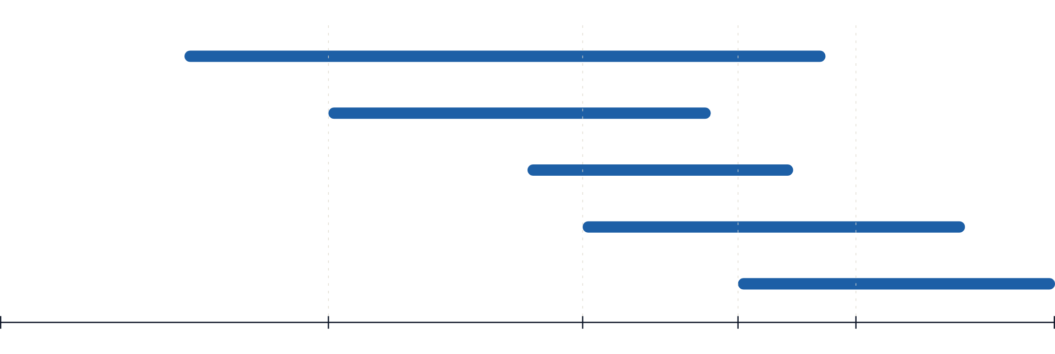
Speed: science has a shelf life
03 · ALERT BROKERING
GRB afterglow
A broker’s budget: seconds
Shock cooling, flash features
Kilonova
Rubin issues each alert about a minute after the exposure
Type Ia supernova
Tidal disruption event
1 min
1 hour
1 day
1 week
1 month
1 year
time since the event →
Notes:
~1.5 min. Log time axis, time since the event, schematic: each bar runs to roughly when the source fades out of reach. A GRB optical afterglow fades as a power law, so a bright one stays detectable for weeks, but the spectroscopic redshift and the early physics (reverse shock, color evolution) need the first day, and an orphan afterglow has to be recognized as fast-fading within the first night. Shock cooling and flash-ionization features in young supernovae are gone within a few days. Kilonovae fade within about a week in the optical, two in the infrared. Slower events give more slack: a type Ia stays visible for months, a tidal disruption event for about a year. LSST's depth keeps things detectable for longer (an afterglow roughly 20 times longer than in ZTF), but the earliest data stays the most valuable. So a broker cannot add hours of latency: its budget is seconds, and real-time ML results only matter if they arrive before the observing decision is made.

Slide 9
Multi-messenger astronomy
03 · ALERT BROKERING
Gravitational waves
The needle in the haystack problem
LIGO–Virgo–KAGRA · next run (IR1) from early 2027
Neutrinos
IceCube
Localizations range from arcminutes to thousands of square degrees. Rubin sees many unrelated transients inside each one, and the counterpart has to be found within hours.
Gamma rays
Fermi, Swift, SVOM
X-rays
GW170817: the kilonova AT2017gfo was found about 11 hours after the merger.
Einstein Probe, Swift
Notes:
~1.5 min. Other messengers send alerts too: gravitational waves from LIGO–Virgo–KAGRA, neutrinos from IceCube, gamma-ray bursts from Fermi, Swift and SVOM, X-ray transients from Einstein Probe. Their localizations go from arcminutes to thousands of square degrees. Inside a large GW region, Rubin will see many unrelated supernovae, AGN flares and asteroids. Finding the one counterpart needs a time window around the trigger, the localization itself, the distance from the GW signal compared with the host redshift, and fast classification. GW170817 is the reference case: the kilonova was found about 11 hours after the merger. The next LVK observing run (IR1) starts in early 2027, so this is timely.

Slide 10
Rubin’s seven full-stream brokers
03 · ALERT BROKERING
ALeRCE
AMPEL
ANTARES
Fink
Chile
Germany
United States
France
Babamul
Lasair
Pitt-Google
United States · powered by BOOM
United Kingdom
United States
Each receives Rubin’s full alert stream. They are complementary, and many science teams use more than one. The rest of this talk is about the one built on BOOM.
Notes:
~1.5 min. Rubin sends its full alert stream to seven community brokers: ALeRCE, AMPEL, ANTARES, Babamul, Fink, Lasair and Pitt-Google. Each makes different choices about classification, filtering and access, and downstream services build on top of them. Be generous to the others here; the audience will use several. Then pivot: Babamul is the public face of BOOM, and the rest of the talk is about what BOOM does that you will not find all in one place elsewhere. (Check the current broker list and countries on the Rubin website before the talk.)

Slide 11
BOOM
04 · THE BOOM BROKER
Burst & Outburst Observations Monitor
An open-source alert broker written in Rust, built to be modular, scalable and fast. It powers Babamul.
Four live surveys
Open source
Published
ZTF, Rubin LSST, DECam and WINTER
github.com/boom-astro/boom
Jegou du Laz et al. 2025, arXiv:2511.00164
Notes:
~1 min. BOOM stands for Burst and Outburst Observations Monitor. It is written in Rust for speed and memory safety, and it is built from independent worker types so each stage scales on its own. It is fully open source, it is described in Jegou du Laz et al. 2025, and it runs the Babamul service, which is how you will access it. Today it processes ZTF, Rubin LSST, DECam and the near-infrared WINTER survey side by side.

Slide 12

Architecture: one pipeline per survey
04 · THE BOOM BROKER
Consume
Ingest
Enrich
Filter
Deliver
Kafka consumer
Alert workers
Enrichment workers
Filter workers
Kafka · API
Reads the survey’s alert stream
Format, store and cross-match
Run every user’s filter
SkyPortal
ML on GPU, light-curve fits, Babamul
stream
MongoDB
Milvus
Alerts, objects and cutouts: the storage, cross-match and filter engine
Embeddings for similarity search
Rust throughout · Valkey queues between stages · a scheduler runs each survey’s worker pools
Notes:
~2 min. Walk the diagram left to right. A Kafka consumer reads each survey’s stream into an in-memory Valkey queue. Alert workers format each packet, store the alert, object and cutouts in MongoDB, and cross-match against catalogs and the other surveys. Enrichment workers run the ML models (batched on GPU) and the light-curve fits, and write results back; embeddings go to Milvus. Filter workers run every user’s filter and push passing alerts to Kafka for Babamul users and marshals like SkyPortal. Every survey gets its own copy of this pipeline, so a burst on one stream never slows another, and the queues between stages absorb spikes.

Slide 13
What makes BOOM unique
04 · THE BOOM BROKER
Parallel processing of many surveys
Catalog cross-matching and host galaxies
Cross-survey cross-matching
Real-time ML results
Light-curve fitting and its data products
Embedding space and similarity search
Filtering and marshal connection
API access
Multi-messenger capabilities
Where BOOM stands apart from other brokers
Notes:
~30 s. Roadmap for the rest of the talk: nine capabilities, each on its own slide. Do not read the list. Point at the three dark boxes, where BOOM stands apart: it runs ZTF, LSST, DECam and WINTER through one pipeline with one schema; it links the same object across surveys, so light curves, fits and ML draw on all of them; and it serves learned embeddings, from a multimodal classifier, that you can search for similar objects as the stream comes in. The rest are what any good broker needs, and BOOM does them in the same fast, open pipeline.

Slide 14
Four surveys, processed in parallel
04 · BOOM · MULTI-SURVEY
ZTF
Rubin LSST
DECam
WINTER
optical · g r i
optical · u g r i z y
optical
near-infrared
Palomar 48-inch Schmidt, northern sky
8.4 m Simonyi Survey Telescope, southern sky
Blanco 4 m, Cerro Tololo
1 m telescope at Palomar
Each survey gets its own consumer, queues, workers, database collections and output stream. A burst on one stream never slows another, and adding a survey does not mean rebuilding the broker.
Next: Argus Array
Notes:
~1.5 min. Most brokers are built around one survey. BOOM was designed from the start to run several side by side: ZTF in the north, Rubin LSST in the south, DECam programs, and WINTER in the near-infrared. Each gets an independent copy of the pipeline, sized for its own alert rate. For you, this means the same API, the same filter language and the same enrichment across surveys. The Argus Array is next on the list.

Slide 15
13 catalogs, UV to infrared
04 · BOOM · CATALOG CROSS-MATCHING
UV
Optical
Infrared
GALEX
Gaia DR3
Pan-STARRS DR2
Legacy Survey DR10
2MASS
AllWISE
CatWISE2020
Context and redshifts
DESI DR1
NED
Milliquas
VSX
TNS
spectroscopic redshifts
Local Volume galaxies
quasars and AGN
variable stars
known transients, synced live
Notes:
~1.5 min. Every alert is matched by position against archival catalogs: GALEX in the UV; Gaia, Pan-STARRS and the Legacy Surveys in the optical; 2MASS, AllWISE and CatWISE in the infrared. On top of that come context catalogs: DESI DR1 redshifts (including a dwarf-galaxy sample), the NED Local Volume Sample, Milliquas for quasars, VSX for known variables, and the Transient Name Server, kept in sync continuously. Radii and returned fields are tuned per survey and per catalog. So every alert arrives already knowing whether it sits on a known star, quasar, variable or reported transient. For ML these are free, physically meaningful features. Next: X-ray and gamma-ray catalogs (eROSITA eRASS1, XMM-Newton 5XMM-DR15, Swift 2SXPS, Fermi-LAT 4FGL-DR4) are already defined in BOOM and switch on once they are ingested. (13 is the ZTF count; LSST and DECam also match the Legacy Surveys point-source catalog.)

Slide 16
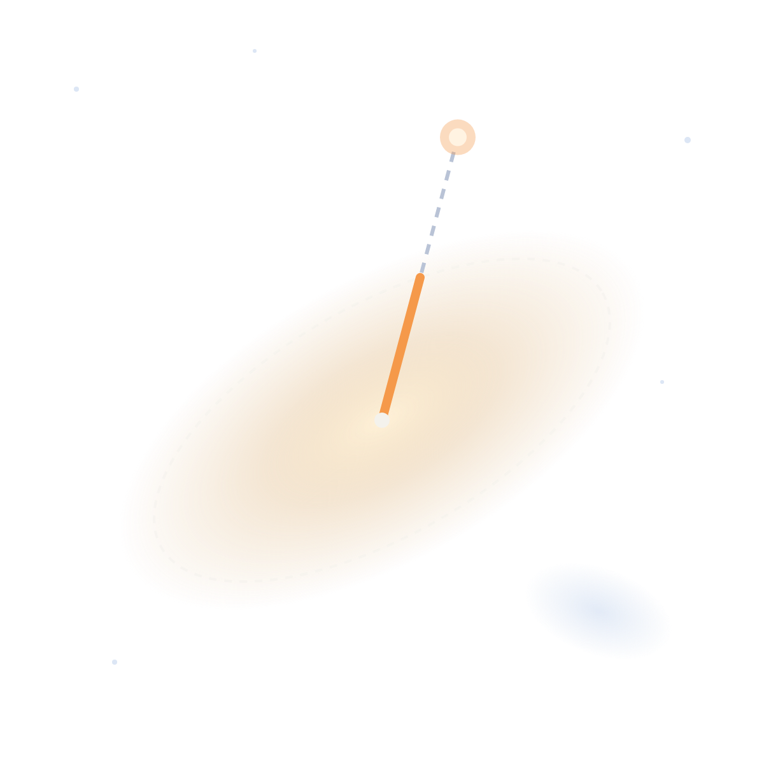
Host-galaxy association
04 · BOOM · HOST GALAXIES
Candidate hosts are ranked by d_DLR: the offset in units of the galaxy’s light radius toward the transient. BOOM keeps the best host with a posterior, and the probability of no host.
transient
separation
Redshift, best source first
DLR
DESI spectroscopic
NED spectroscopic
Legacy Surveys spectroscopic
NED photometric
Legacy Surveys photo-z
host galaxy
other candidate
Notes:
~1.5 min. Nearest-in-angle is a poor host choice for large, inclined galaxies. BOOM uses the directional light radius (DLR): the galaxy’s light radius measured along the direction to the transient. d_DLR is the separation divided by that radius, so a transient in the outskirts of a big disk can still beat a small galaxy that is closer in arcseconds. The best host comes with a posterior probability and a probability that the true host is undetected. Its redshift comes from the best available source, from DESI spectra down to Legacy Surveys photometric redshifts, and gives distance, physical offset in kpc, and absolute magnitude. These are among the strongest features you can give a classifier, and they are what makes GW volume matching possible later. In filters and API results, look under host_galaxy.best_host (z, dist_mpc, sep_kpc, d_dlr, posterior).

Slide 17
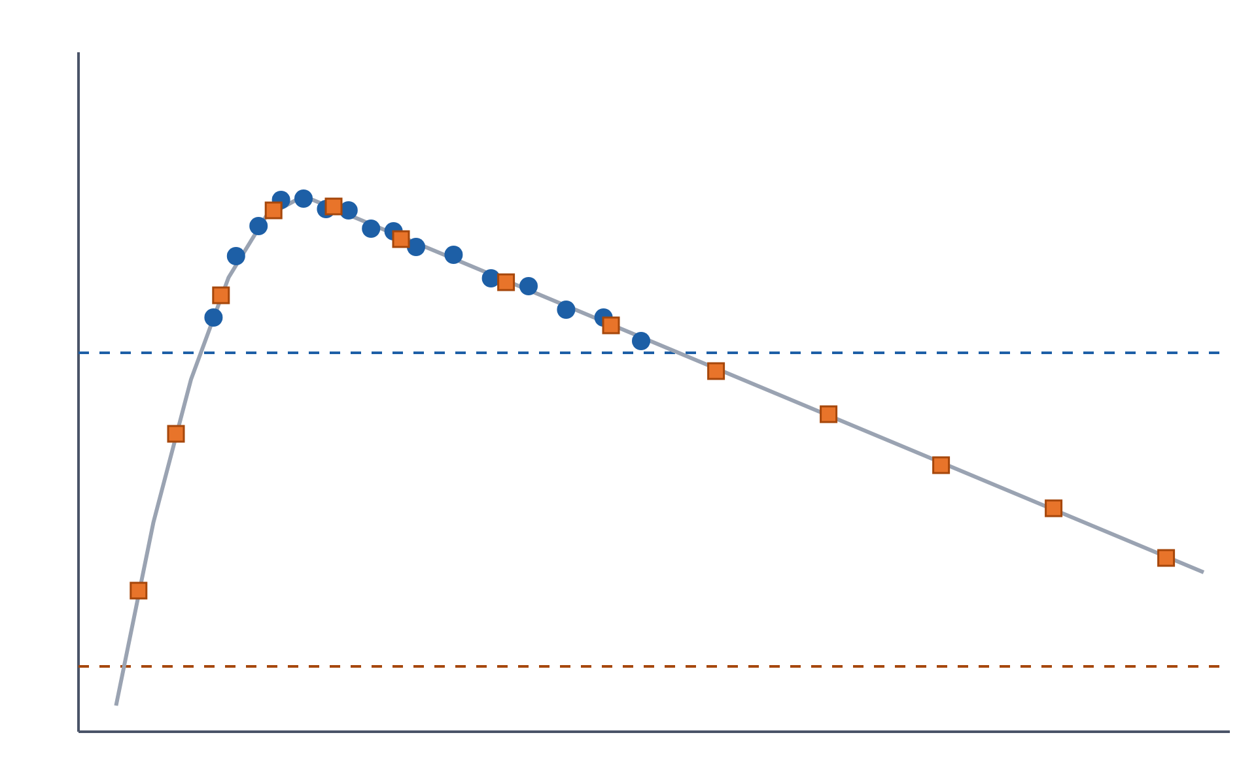
One object, every survey
04 · BOOM · CROSS-SURVEY
ZTF (circles) sees the peak. LSST (squares) adds the faint rise and the long tail.
brighter ↑
Every alert is linked to the same object in the other surveys BOOM ingests
ZTF limit
Filters on one survey can read the other survey’s photometry
Light-curve fits combine ZTF and LSST g and r points
LSST limit
time →
Notes:
~1.5 min. Schematic, not real data. ZTF and Rubin overlap on a large part of the sky. ZTF has the cadence and the bright end, LSST has the depth. BOOM links each alert to the same object in the other surveys it processes (ZTF, LSST and DECam), so a ZTF filter can look at the LSST photometry for the same source, and the real-time light-curve fits use both. For ML this means longer, better-sampled multi-band light curves without doing any cross-survey matching yourself. The same idea works for asteroids: a nightly linker groups tracklets from different nights and different surveys into tracks of one moving object.

Slide 18

ML scores in real time
04 · BOOM · REAL-TIME ML
Model | What it tells you | Inputs
ACAI | Five scores: hosted, nuclear, orphan, variable star, bogus | Metadata + cutouts
BTSbot | Is this a bright transient worth a spectrum? | Metadata + cutouts
AppleCiDEr | Eight-class hierarchical label with uncertainty, plus an embedding | Light curve + metadata + cutouts
Batched ONNX inference on GPU, inside the pipeline
Notes:
~2 min. Three model families run on alerts as they arrive (on ZTF today; confirm the LSST model timeline before the talk). ACAI is a set of five binary classifiers: hosted, nuclear, orphan, variable star and bogus. BTSbot (Rehemtulla et al.) automates the Bright Transient Survey: it scores whether a source is a bright transient worth spectroscopic follow-up. AppleCiDEr is a multimodal fusion model that reads the light curve, metadata and image cutouts together. All models run as ONNX, batched on GPU, so inference does not hold up the stream. For ML people, emphasize provenance: each alert points to an enrichment set recording which model versions, identified by hash, produced its scores. When a model is retrained, you can tell old scores from new ones. And because the models are plain ONNX, a model trained by someone in this room could run in the pipeline.

Slide 19
AppleCiDEr knows when to abstain
04 · BOOM · REAL-TIME ML
Transient
Supernova
Ia-like SN
Stripped-envelope SN
H-rich CCSN
Evidential: predicts a distribution over class probabilities, so uncertainty is part of the output.
Superluminous SN
Nuclear transient
TDE
Hierarchical: reports the deepest level it trusts (class, else family, else domain) or abstains.
Variable
Nuclear variable
AGN-like
Honest about novelty: flags out-of-distribution alerts.
Stellar variable
Accreting WD variable
Other stellar variable
Notes:
~1.5 min. AppleCiDEr is the model most worth explaining to an ML audience. It is a multimodal fusion model over the light curve, alert metadata and the science, template and difference cutouts. It is evidential: it outputs Dirichlet concentration parameters rather than a single softmax, so it can separate “confidently ambiguous” from “has never seen anything like this”. The taxonomy is hierarchical: eight leaf classes, grouped into families and two domains, and coarser levels are exact sums of the leaves. Each level is gated by its own uncertainty threshold, set for 80% coverage, and the model reports the deepest level that passes. So when it is unsure about the subtype, it says Supernova rather than guessing. On kept predictions it reaches macro F-beta of 0.99 at domain level, 0.83 at family and 0.64 at class level. It also flags out-of-distribution inputs, which is exactly what you want for anomaly searches. Its internal representation is the embedding used for similarity search, two slides from now.

Slide 20
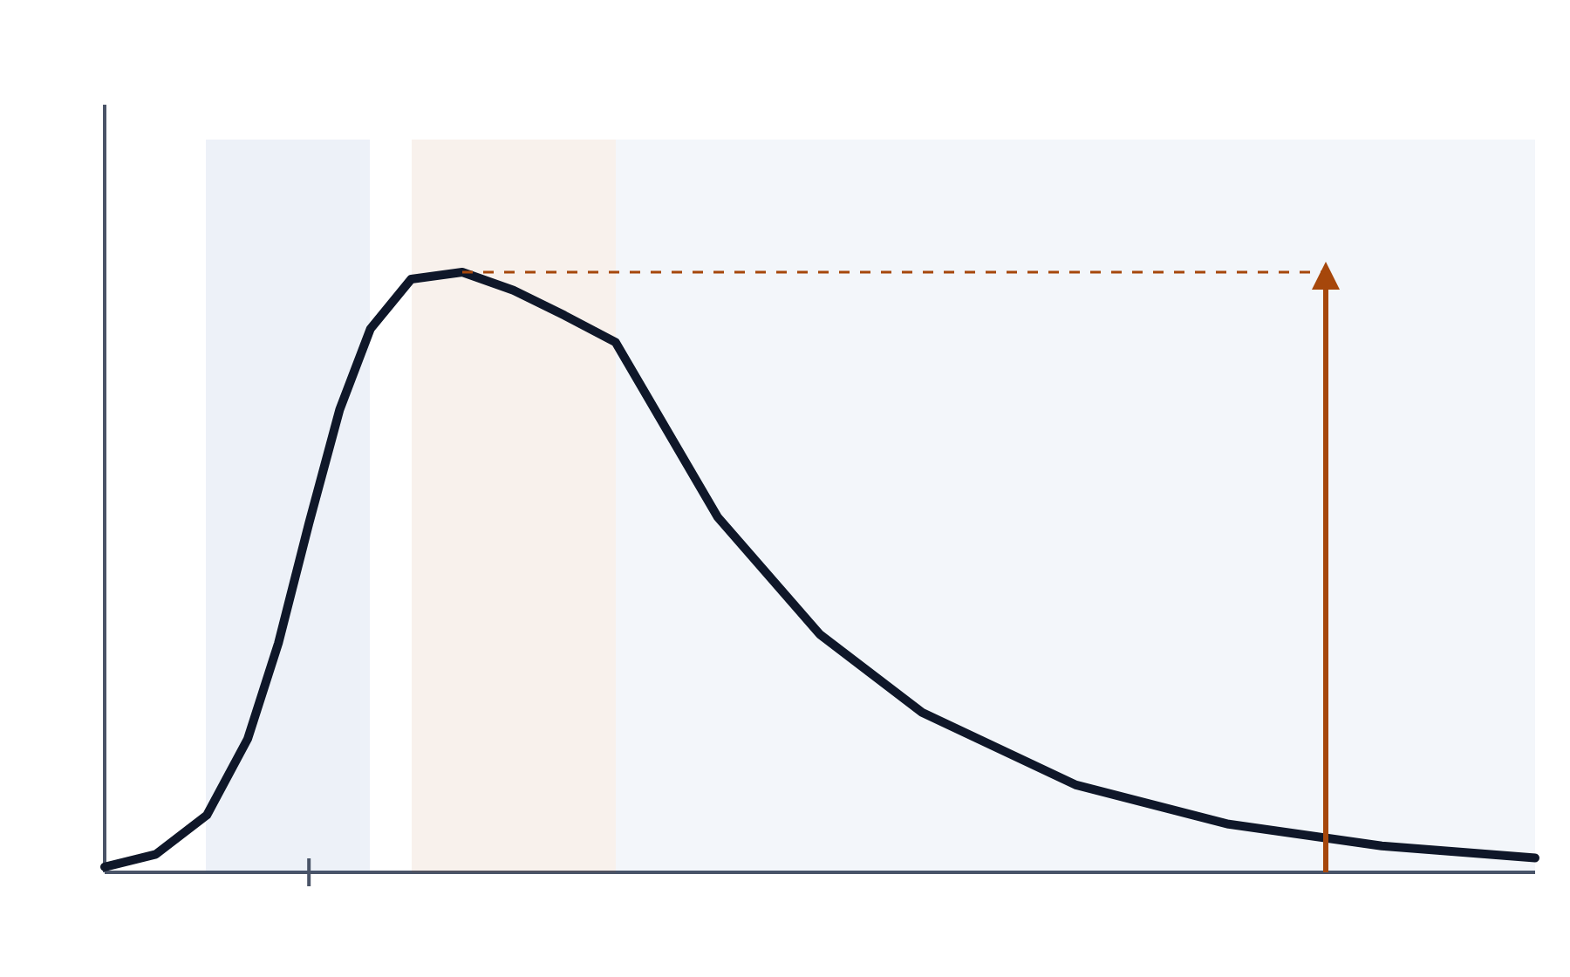
Light-curve fits in real time
04 · BOOM · LIGHT-CURVE FITTING
The Villar et al. (2019) supernova model, fit jointly in g and r for every ZTF alert.
rise
τ_rise
plateau
γ, β
GPU particle-swarm optimizer, then a Nelder–Mead polish
Uses detections, forced photometry
decline
τ_fall
Per alert: 7 parameters per band, χ², peak magnitude, peak time
A
Next: afterglow (broken power-law) and Gaussian-process fits
t₀
time →
Notes:
~1.5 min. Every ZTF alert enriched on a GPU gets an analytic light-curve fit, using the Villar et al. 2019 model: a sigmoid rise, a plateau with a linear slope, and an exponential decline. It is fit jointly in g and r with a GPU particle-swarm optimizer, then polished with Nelder–Mead. The fit uses ZTF detections and forced photometry, plus g and r points from the matched LSST object. It is stored per alert, so you can watch the parameters converge as the light curve fills in. For ML, these are compact, physically meaningful features: rise and decline times separate SN classes well, and the reduced chi-squared flags things that do not look like supernovae at all. Next come smoothly broken power-law fits for afterglows and non-parametric Gaussian-process fits. Fields live under villar_fit in the alert, or through the villar-fit API endpoint.

Slide 21
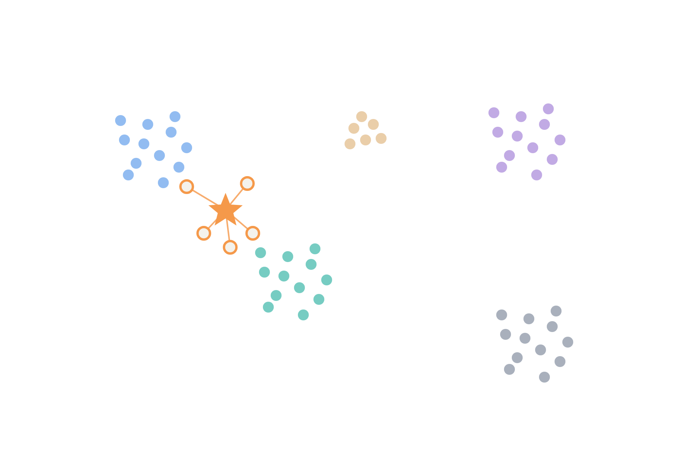
Embedding space and similarity search
04 · BOOM · EMBEDDINGS
“Show me objects like this one.”
SN Ia
TDE
AGN
AppleCiDEr fusion embedding: 384 dimensions, unit length
One vector per object in a Milvus vector database, compared by cosine similarity
Results come back with their classifications
your object
Use it for search, anomaly hunting, active learning and label propagation
SN II
Sneha will give a talk on this tomorrow
Variable stars
Notes:
~1.5 min. Schematic picture, not a real projection. AppleCiDEr’s fusion layer produces a 384-dimensional, L2-normalized embedding for each object, combining light curve, metadata and images. BOOM stores the latest one per object in a Milvus vector database, so you can ask for the nearest neighbors of any object by cosine similarity, through the API or the Embeddings page of the Babamul web app, and the results come back with their AppleCiDEr classifications. For this audience: this gives you a ready-made representation space. Use it to find analogs of a rare event, to find objects far from everything else (anomalies), to pick informative examples for labeling (active learning), or to spread a few labels to their neighbors.

Slide 22
Filters: your science, running live
04 · BOOM · FILTERING
[
{ "$match": {
"candidate.drb": { "$gt": 0.8 },
"classifications.btsbot": { "$gt": 0.5 },
"properties.star": false,
"host_galaxy.best_host.d_dlr": { "$lt": 2 }
}},
{ "$project": {
"objectId": 1,
"annotations.host_z":
"$host_galaxy.best_host.z",
"annotations.class":
"$classifications.applecider_fusion.decision_label"
}}
]
1
Write
A MongoDB pipeline over the enriched alert: every field from this talk
2
Test
Run it on stored alerts and count matches before going live
3
Deploy
Versioned, and run on every new alert in real time
4
Act
Matches stream to your Kafka topic and on to SkyPortal or Fritz for follow-up
Notes:
~1.5 min. An illustrative filter, not a production one. Filters are MongoDB aggregation pipelines run over the fully enriched alert, so everything from the last few slides is available: real-bogus scores, ML classifications, catalog flags, host-galaxy offsets and redshifts, fit parameters. This one keeps likely-real alerts that BTSbot likes, that are not on a known star, and that sit within two light radii of their host, and it annotates each with the host redshift and the AppleCiDEr label. You can test a filter against stored alerts and get a match count before deploying it; filters are versioned; once live they run on every new alert. Anything that passes is pushed to a Kafka topic and on to marshals like SkyPortal or Fritz, where people coordinate follow-up. This is where your ML model plugs into real follow-up decisions.

Slide 23
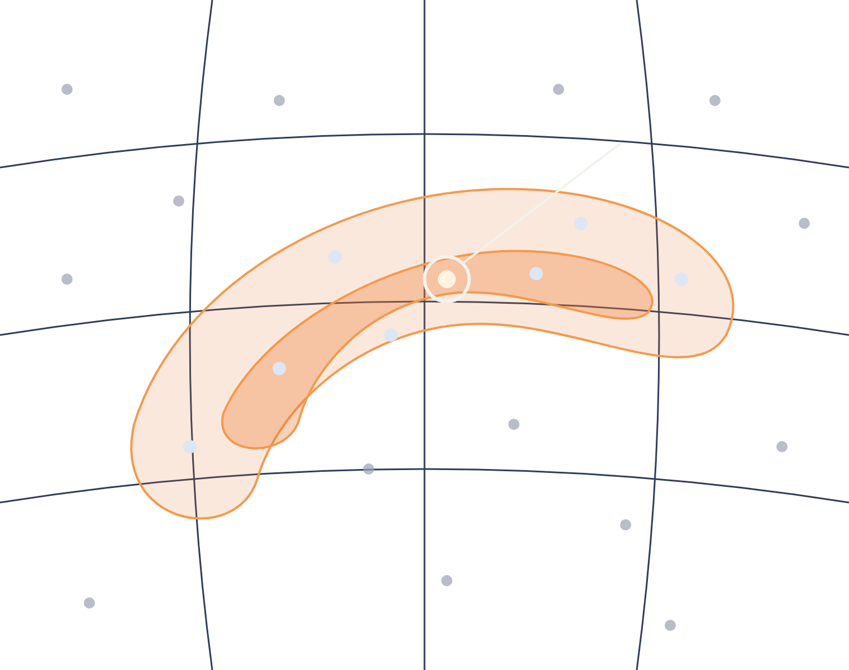
Search any localization
04 · BOOM · MULTI-MESSENGER
counterpart
GW · 3D skymap
Ranked by credible volume at the host’s distance
γ-ray Neutrino Xray · 2D probability map
Kept inside a credible region
All within a time window around the trigger
50%
90%
Notes:
~2 min. Schematic picture. This is BOOM’s answer to the needle problem from earlier. You hand it a localization and a time window, and it returns the candidates. For a gravitational-wave event with a 3D skymap, BOOM splits the map into voxels of sky pixel times distance bin, ranks them by probability density, places each candidate at the distance implied by its host galaxy’s redshift, and gives it the smallest credible level whose volume contains it. That is a real volume match, not just a 2D cut. For a gamma-ray burst map, it keeps candidates inside a credible region; for neutrino or X-ray error regions, any region expressed as a MOC works. It is available through the skymap-search endpoint and when testing filters. The test suite checks it on GRB 200524A: the Fermi GBM localization recovers ZTF20abbiixp, the burst’s optical counterpart, first detected within a day of the trigger. With the next LVK run in early 2027, this is ready now.

Slide 24
Why BOOM for your ML work
05 · WHY BOOM
If your model needs… | BOOM gives you…
Rich context features | 13 catalog cross-matches and a host galaxy with redshift
Longer light curves | ZTF, LSST, DECam and WINTER linked per object
Baselines to beat | ACAI, BTSbot and AppleCiDEr scores, with uncertainty
Representations | 384-d embeddings with similarity search
Physics-based features | Villar fit parameters, updated with each alert
A path to production | Your filter on the live stream, results to skyportal
Notes:
~1.5 min. This closes the loop on the slide about what ML on alerts needs. Go row by row quickly: context features from cross-matches and host galaxies; longer light curves from linked surveys; existing classifier scores you can use as baselines or as inputs; a ready-made embedding space; physically meaningful fit parameters; provenance for every score; and a direct route from a trained model to a filter running on the live stream. The message: you can spend your time on the model, not on building the data pipeline.

Slide 25


05 · WHY BOOM
1
2
3
Sign up
Fetch
Train/ Infer
A Babamul account with email, Google, GitHub or ORCID
Query the API or subscribe to Kafka streams
On enriched alerts: features, scores, embeddings and fits
Step 2 is the next talk: Thomas will talk on fetching BOOM data from the API, hands-on.
Notes:
~1 min. The practical takeaway. One: sign up for Babamul; it takes a minute. Two: get data, by querying the API for history or subscribing to the Kafka streams for live alerts; that is exactly what the next talk covers. Three: train your model on enriched alerts, using the cross-matches, scores, embeddings and fits rather than raw packets. Four: deploy, as a filter that runs on every new alert and pushes what it finds to you or your follow-up marshal. Introduce your colleague here.

Slide 26
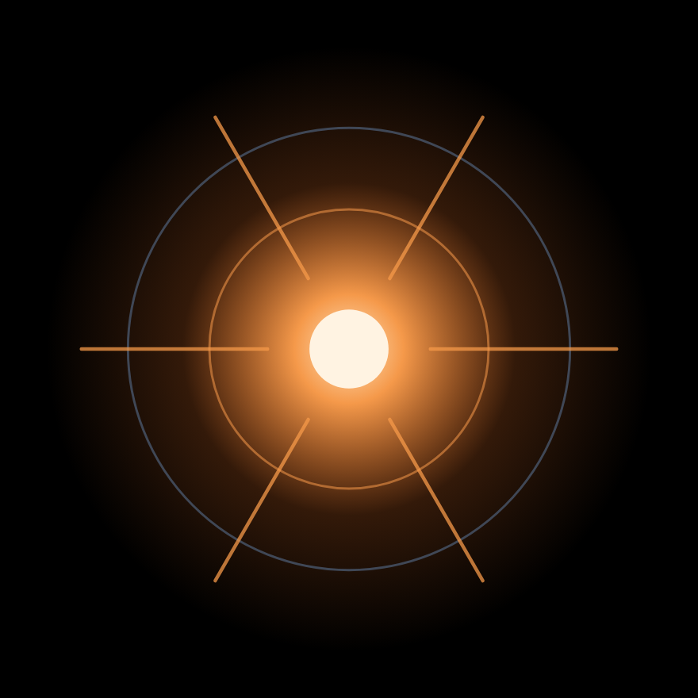
Use BOOM as
your broker.
05 · WHY BOOM
Babamul
Code
babamul.caltech.edu
github.com/boom-astro/boom
Python client
Paper
github.com/boom-astro/boom-client
arXiv:2511.00164
Questions?
Notes:
~30 s, then questions. One-sentence summary: Rubin turns discovery into a selection problem; BOOM gives you the context, the ML results, the embeddings and the real-time filtering to solve it, across surveys, through one open API. Leave this slide up during questions so people can copy the links. Swap babamul.caltech.edu for babamul.umn.edu if that is the instance you want to advertise.

Slide 27
Three ways in, through Babamul
04 · BOOM · API ACCESS
Web app
Kafka streams
REST API
Objects, light curves, cutouts, queries and similar objects. Sign in with email, Google, GitHub or ORCID.
Public, enriched ZTF and LSST alerts pushed to you as they happen, with your own credentials.
Token-based access, interactive docs, and the boom-client Python package.
Under /babamul
/surveys/{survey}/alerts
/surveys/{survey}/alerts/cone-search
/surveys/{survey}/objects/{id}
/surveys/{survey}/objects/{id}/cross-matches
/surveys/{survey}/cutouts
/surveys/{survey}/villar-fit
/surveys/{survey}/alerts/skymap-search
/similarity/objects
Hands-on next: Thomas shows how to fetch all of this from the API.
Notes:
~1 min. Keep this short; the next talk goes deep. Everything is served through Babamul. The web app is the quickest way to look around: object pages with light curves, cutouts, cross-matches and similar objects, plus a query page. Kafka streams push the public enriched ZTF and LSST alerts to you in real time with your own credentials. The REST API gives programmatic access with a token, documented interactively, with a Python client, boom-client. These endpoints cover alerts, cone searches, objects and their cross-matches, cutouts, light-curve fits, skymap searches and similarity search. Hand over explicitly to your colleague here.

